Slide 1

ChrysalisApp.com
Daniel Shafer, Ryan Au, John Hess, Andrew Donato

Slide 2







Front-end Technologies

Slide 3


Back-end Technologies

Slide 4


Honorable Mentions

Slide 5
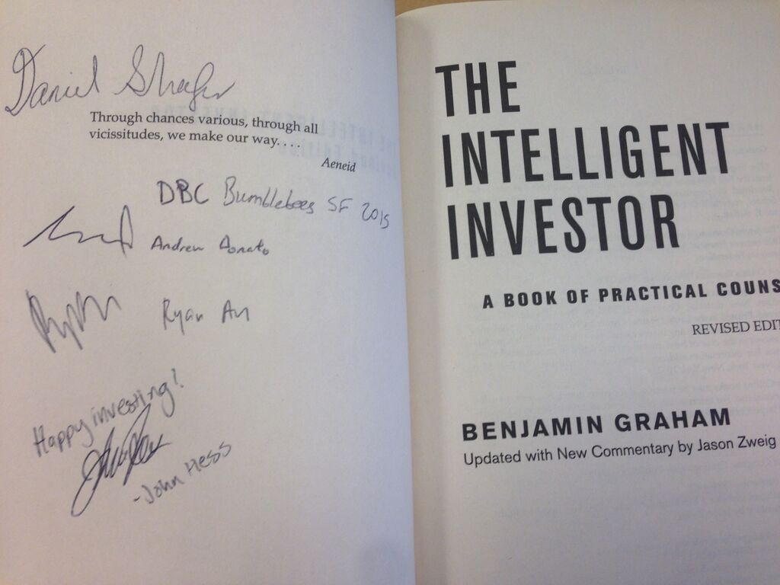
Team & Culture

Slide 6

For your viewing pleasure, a demonstration
Please navigate your computing devices to chrysalisapp.com and turn up your attention to 11.
Chrysalis does this: so you don’t have to do it yourself

